Slide 1
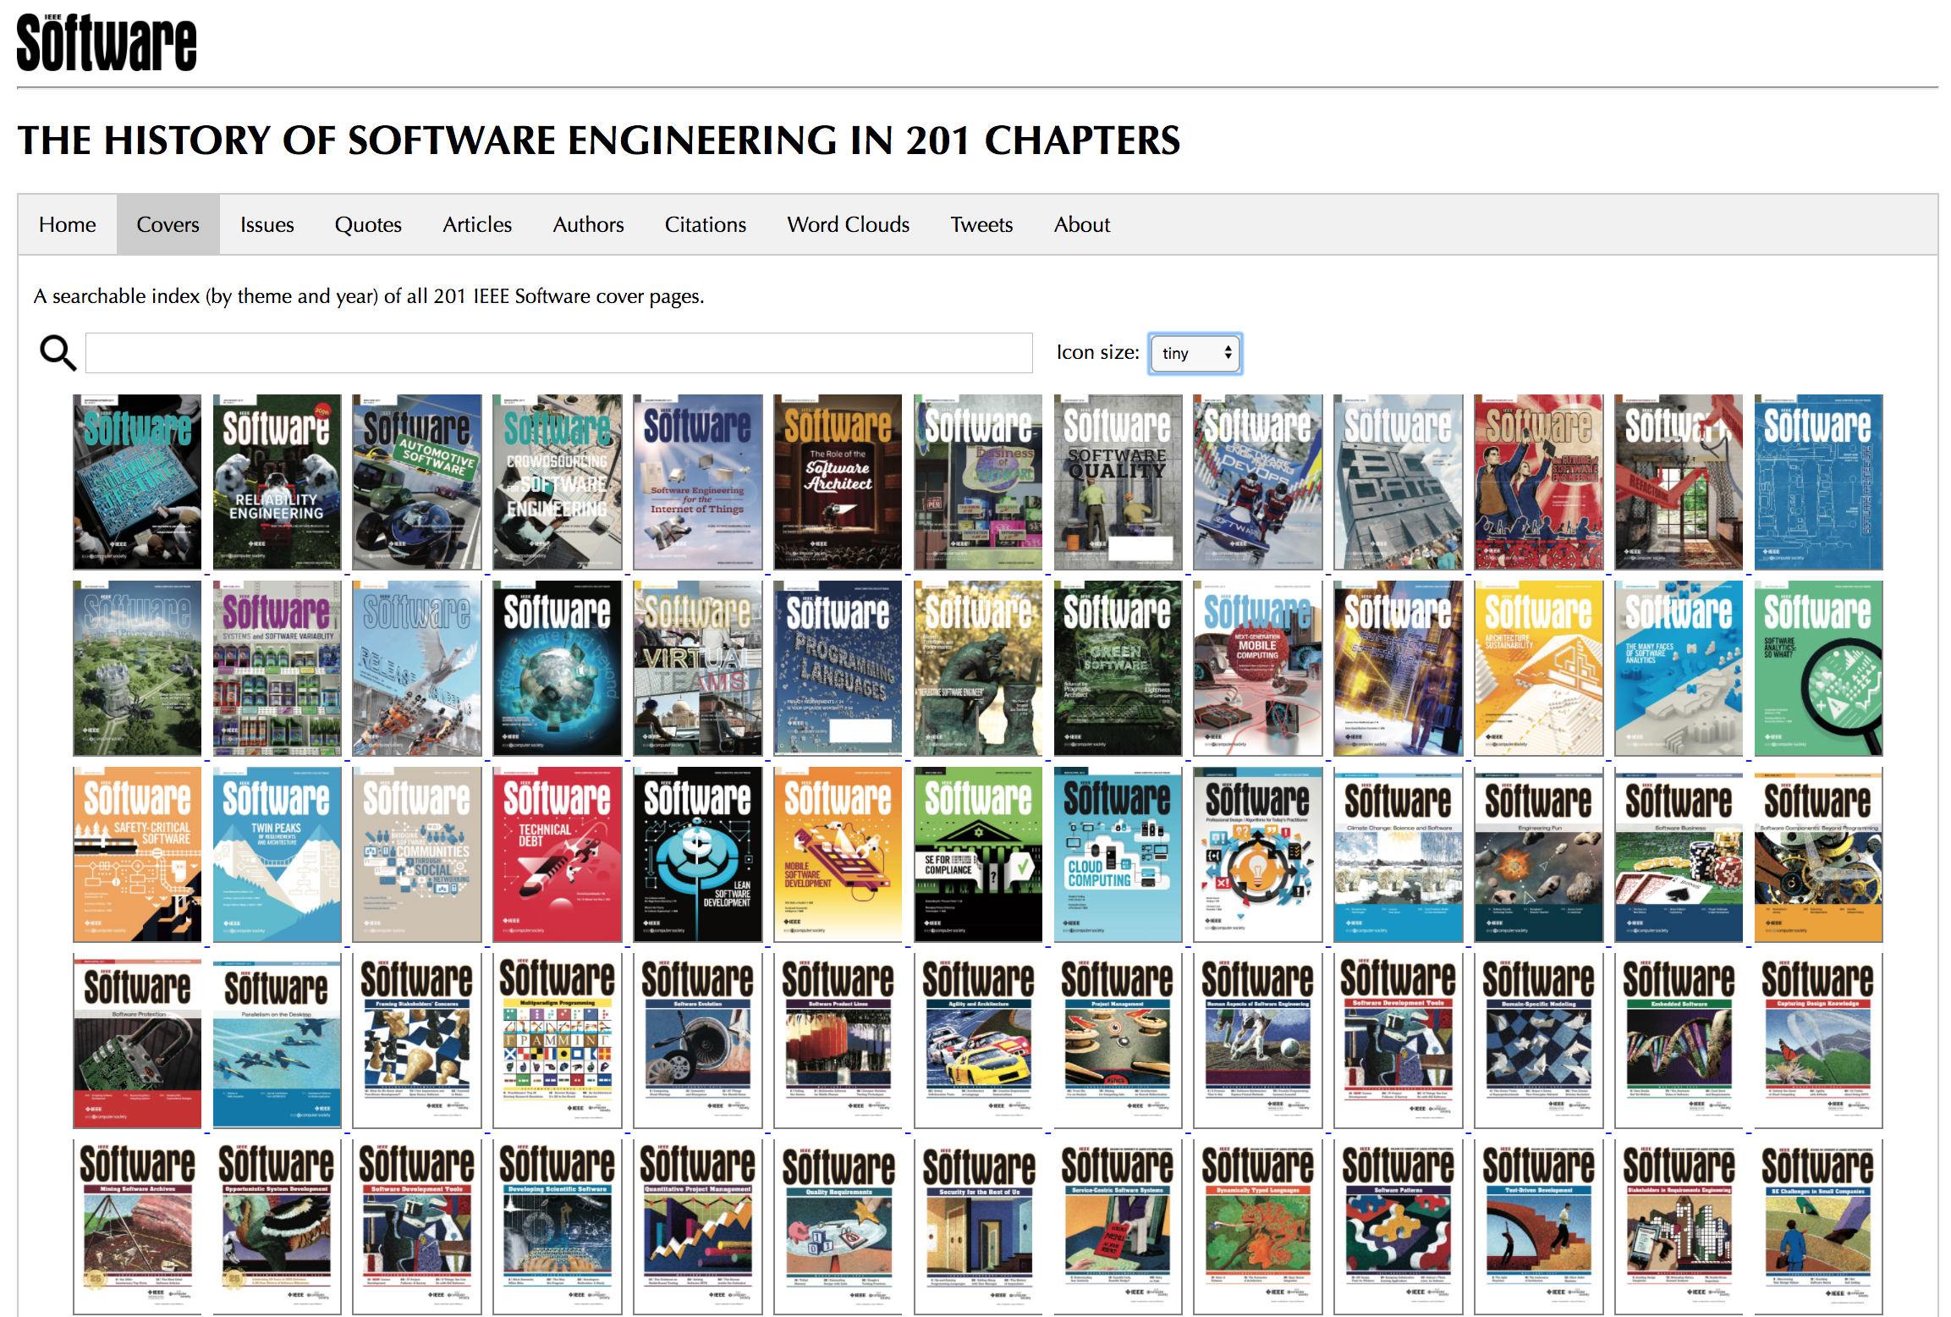

Slide 2
Hans’
Professional
History
Software
Engineering
History
This
Presentation

Slide 3
Hans’ Professional History: 38 years, 12 positons

Slide 4

1979 – 1983: Software Development Engineer

Slide 5
1979 – 1983: The “Prehistorical” Period

Slide 6
1984 – 1987: Software Development Engineer

Slide 7
1984 – 1987: Software Engineering as a Discipline

Slide 8

1988 – 1989: Product Manager

Slide 9
1988 – 1989: CASE Tools, 4GLs, Expert Systems…

Slide 10
1990 – 1992: Marketing Manager
Circle Software

Slide 11
1990 – 1992: Metrics, Maintenance, Testing…

Slide 12
1993 – 1997: SE Consultant
Digital Equipment

Slide 13
1993 – 1997: OO, Measurements, Quality…

Slide 14
1997 – 2000: Project Manager
Software Engineering Research Center (SERC)

Slide 15
1997 – 1999: Certifications, Linux, Risks…

Slide 16
2000 – 2001: Business Manager
Shared Objectives

Slide 17
2000 – 2001: Estimations, Requirements, Cobol…

Slide 18
2001 - 2004: Advisor

Slide 19
2001 – 2004: Product Lines, Inspections, XP, MDD…

Slide 20
2004 – 2009: Independent Consultant

Slide 21
2004 – 2009: Patterns, TDD, Project Management…

Slide 22
2010 - : Management Consultant

Slide 23
2010 - : back to the basics + new trends

Slide 24
History repeating

